Slide 1
ISB 120
(Ph.D WIP, LECTURER NAME:
MULENGA MPOLOKOSO
(Ph.D_WIP, MBA, BBA, BICTED, BSCFO, TM, ISP, CMP)

Slide 2
Unit 2: Supply and Demand Analysis
⦁ The law of demand: factors influencing consumer demand
⦁ The law of supply: factors influencing producer supply
⦁ Market equilibrium and price determination: the interplay of supply and demand
⦁ Shifts in supply and demand curves: causes and consequences
⦁ Price elasticity of demand and supply: measuring responsiveness to price changes
⦁ Cross-price elasticity and income elasticity
⦁ Price controls and their impacts on markets
⦁ Case studies of supply and demand in specific industries
⦁ Government intervention in markets and its effects
⦁ Global supply and demand considerations and international trade implications

Slide 3
The law of demand: factors influencing consumer demand
In general, Demand means desire by human.
In economics, Demand refers to the desire backed by ability to pay and willingness to buy it.
A beggar may desire to have a car, but his desire is not going to affect its market price as he is not having the necessary purchasing power to buy a car.
Thus, desire backed by purchasing power is called demand.

Slide 4
KINDS OF DEMAND
I. Direct Demand: It refers to demand for a commodity that is directly consumed to satisfy human wants, for example demand for bread, butter and fruits.
a) Price Demand: it refers to the demand for a commodity at a particular price
b) Income Demand: It refers to the demand for a commodity at a various levels of consumer’s income
c) Cross Demand: It refers to quantity demanded of a commodity due to change in the price of other commodity
II. Indirect Demand or Derived Demand:
Demand for factors of production is indirect because they help in the production of a commodity which is directly demanded by the consumer in the market.
III. Complementary Demand/ Joint Demand:
It refers to the demand for those goods for a commodity which are always demanded jointly. Example: car and petrol.
IV. Composite Demand:
It refers to the total demand for a commodity which can be used for various purposes.

Slide 5
LAW OF DEMAND – ALFRED MARSHALL
Definition: The law of demand states that , other things remaining equal,
The quantity demanded for a commodity increases when its price falls and
Decreases when the price rises.
There is a inverse relationship between the price of the good and the quantity demanded of that good.

Slide 6
FACTOR AFFECTING THE DEMAND
1. Price of the Given Commodity: It is the most important factor affecting demand for the given commodity. Generally, there exists an inverse relationship between price and quantity demanded.
2. Price of substitutes/related goods: Some goods can be substituted for other goods. For example, tea and coffee are substitutes. If the price of coffee increases while the price of tea remains the same, there will be increase in the demand for tea and decrease in the demand for coffee.
3. Income of the consumer: When the income of the consumer increases, more will be demanded. Comforts and luxuries belong to this category
4. Tastes and preferences of the consumer: Demand for a commodity may change due to a change in tastes, preferences and fashion.
5. Expectation of future price change: If the consumer believes that the price of a commodity will rise in the future, he may buy a larger quantity in the present. Suppose he expects the price to fall, he may defer some of his purchases to a future date.

Slide 7
ASSUMPTIONS OF THE LAW OF DEMAND
The price of the related goods remains the same
The income of the consumers remain unchanged
Tastes and preferences of the consumer remain the same
DEMAND SCHEDULE FOR ORANGE
Price of Oranges (Kwacha) | Quantity of Oranges
10 | 2
8 | 5
6 | 8
5 | 10

Slide 8
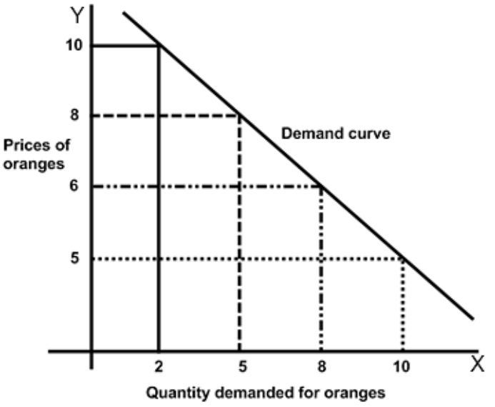
DEMAND CURVE

Slide 9
MARKET DEMAND SCHEDULE
A demand schedule for a market can be constructed by adding up demand schedules of the individual consumers in the market.
Suppose that the market for Apple consists of 2 consumers. The market demand is calculated as follows.

Slide 10
MARKET DEMAND SCHEDULE FOR APPLE
Price (Kwacha) | Quantity Demanded
 | Quantity A | Quantity B | Quantity A+B
12 | 1 | 2 | 3
11 | 2 | 3 | 5
10 | 3 | 4 | 7
9 | 4 | 5 | 9
8 | 5 | 6 | 11

Slide 11
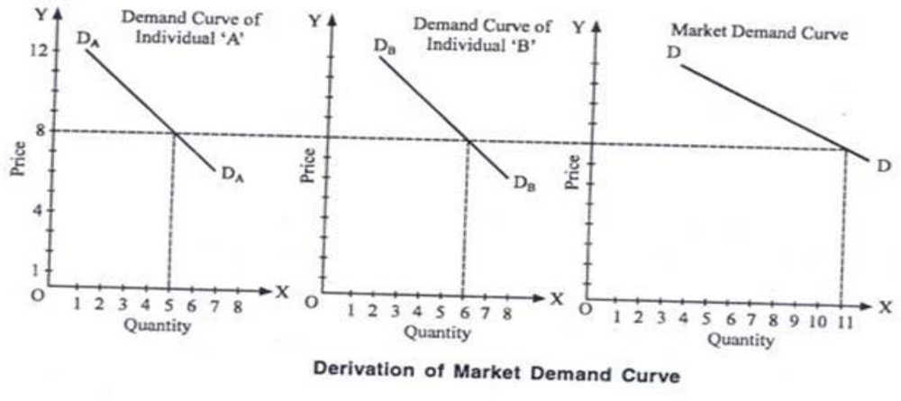
DERIVATION OF MARKET DEMAND CURVE

Slide 12
REASONS BEHIND DOWNWARD SLOPE OF THE DEMAND CURVE
1. Law of diminishing marginal utility: The law of demand is based on the law of diminishing marginal utility which states that as the consumer purchases more and more units of a commodity,
The utility derived from such successive unit goes on decreasing.
Like that, consumer purchases more of the commodity so that his marginal utility from the commodity falls to be equal to the reduced price and vice‐ versa.
2. Substitution Effect: The substitution effect is the effect that a change in relative prices of substitute goods changes the quantity demanded.
When the price of a good rises the consumer prefers to buy its substitute goods which have became relatively cheaper.

Slide 13
CONT…
3. Income Effect: Change in demand on account of change in real income resulting from change in the price of a commodity is known as income effect.
4. Several Uses. Some commodities can be put to several uses which lead to downward slope of the demand curve.
When the price of such commodities goes up they will be used for important purposes, so their demand will be limited.

Slide 14
EXCEPTIONS TO THE LAW OF DEMAND
The Law of demand is a general statement telling that prices and quantities of a commodity are inversely related.
There are certain peculiar cases in which the law of demand will not hold good.
I. Veblen Effect: Veblen has pointed out that there are some goods demanded by very rich people for their social prestige.
When price of such goods rise, their use becomes more attractive and they are purchased in larger quantities.
Demand for diamonds from the richer class will go up if there is increase in price. If such goods were cheaper, the rich would not even purchase.

Slide 15
CONT…
II. Giffen Paradox : Sir Robert Giffen discovered that the poor people will,
Demand more of inferior goods if their prices rise and
Demand less if their prices fall.
For example, poor people spend the major part of their income on coarse grains (e.g. Maize ) and only a small part on rice.

Slide 16
MOVEMENT IN DEMAND CURVE OR EXPANSION AND CONTRACTION OF DEMAND
A movement along the demand curve is caused by a change in the price of the goods only other things remaining constant.
I. Expansion of Demand:
It refers to rise in demand due to fall in the price of the goods.
II. Contraction of Demand:
It refers to fall in demand due to rise in the price of goods.

Slide 17
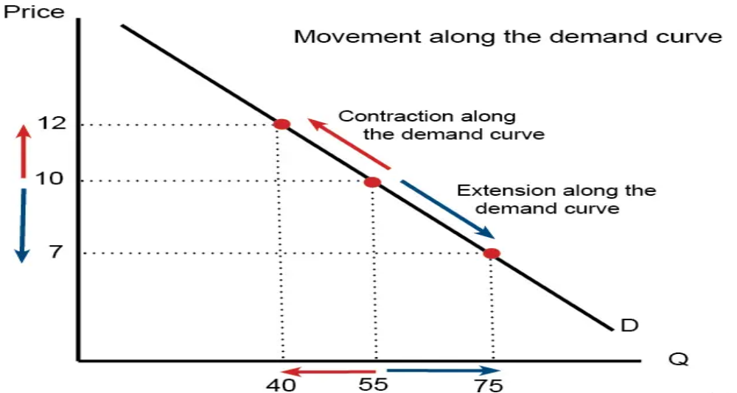
MOVEMENT IN DEMAND CURVE OR EXPANSION AND CONTRACTION OF DEMAND
Expansion in demand: A fall in price from K16 to K12 leads to an expansion (increase) in demand. As price falls, there is a movement along the demand curve and more is bought.
Contraction in demand: An increase in price from K12 to K16 causes a movement along the demand curve, and quantity demand falls from 80 to 60. We say this is a contraction in demand

Slide 18
SHIFTS IN DEMAND OR INCREASE AND DECREASE IN DEMAND
The shift of the demand curve is caused by changes in factors other than price of goods. These factors are
A) Consumer’s income
B) Price of relative or substitute goods
C) Consumer’s taste and preferences
I. Increase in Demand:
It refers to the situation when the consumers buy a large amount of commodity at the same price.
The reasons are;
Increases in the income of consumer
Increase in the price of substitute goods
Expectation of rise in price in future
Increase in population

Slide 19
II. Decrease in Demand:
It refers to a situation when the consumers buy a smaller quantity of thee commodity at the same price.
The reasons are;
Fall in the income of thee consumers
Fall in the price of the substitute goods
Expectation of fall in price
Decrease in Population
Consumers’ taste becoming unfavorable towards the goods

Slide 20


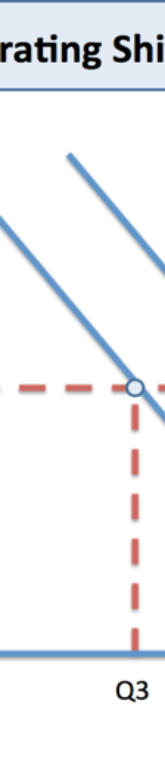
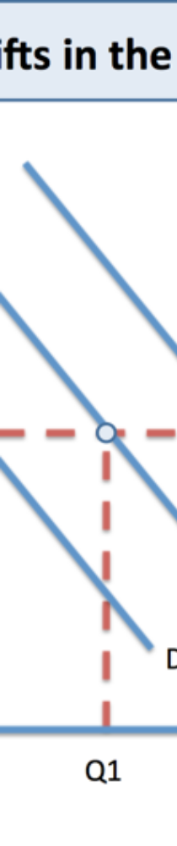
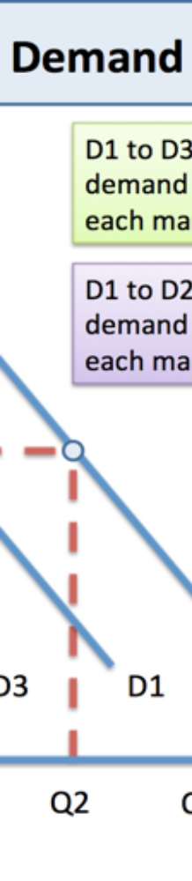
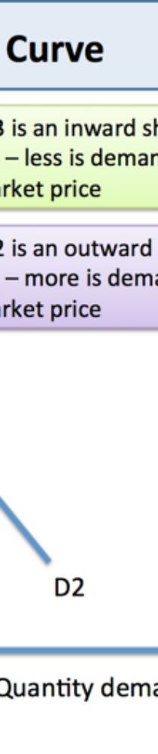

SHIFTTS IN DEMMAND OR IINCREASEE AND DECREASE IIN DEMANND

Slide 21
ELASTICITY OF DEMAND - ALFRED MMARSHAALL
The law of demand explains that demand will change due to the change in the price of the commodity
But does not explain the rate at which demand changes due to changes in price,
The concept of elasticity of demand measures the rate of change in demand
DEFINITION OF ELASTICITY OF DEMAND:
According to him “the elasticity (or responsiveness) of demand in a market is great or small according as the amount demanded increases much or little for a given fall in price, and diminishes much or little for a given rise in price”.

Slide 22
FACTORS DETERMINING THE PRICE ELASTICITY OF DEMAND
1. Availability of Substitute: Goods having close substitutes will have an elastic demand and goods with no close substitutes will have an inelastic demand. Commodities such as Pen, Pepsi, Maruti car have close substitutes and hence have an elastic demand.
2. Income of the consumers: If the income level of consumers is high, the elasticity of demand will be less. It is because change in the price will not affect the quantity demanded by greater proportion
3. Luxuries versus Necessities: The price elasticity of demand is likely to be low for necessities and high for luxuries
4. Number of uses of the commodity: The more the number of uses of a commodity has more elastic demand. If a commodity has few uses it has an inelastic demand.
5. Cost relative to total income: higher the cost of the goods relative to total income of consumer more will be the price elasticity demand.
6. Level of price: if the price of the commodity is high the price elasticity of demand is more and if it is low, its price elasticity of demand is less.

Slide 23
TYPES OF ELASTICITY OF DEMAND
Price Elasticity of Demand
Income Elasticity of Demand
Cross Elasticity of Demand
Advertising elasticity of Demand
Elasticity of Price Expectations

Slide 24
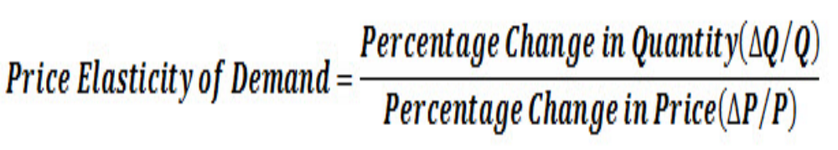
PRICE ELASTICITY OF DEMAND
“The degree of responsiveness of quantity demanded to a change in price is called price elasticity of demand”

Slide 25
DIFFERENT TYPES OF PRICE ELASTICITY OF DEMAND
1. PERFECTLY INELASTIC DEMAND (EP = 0):
Description: when to a percentage change in price there is no change in quantity demanded.
Types of Goods: Essentials like life saving goods
Changes in price yield no change in demand

Slide 26
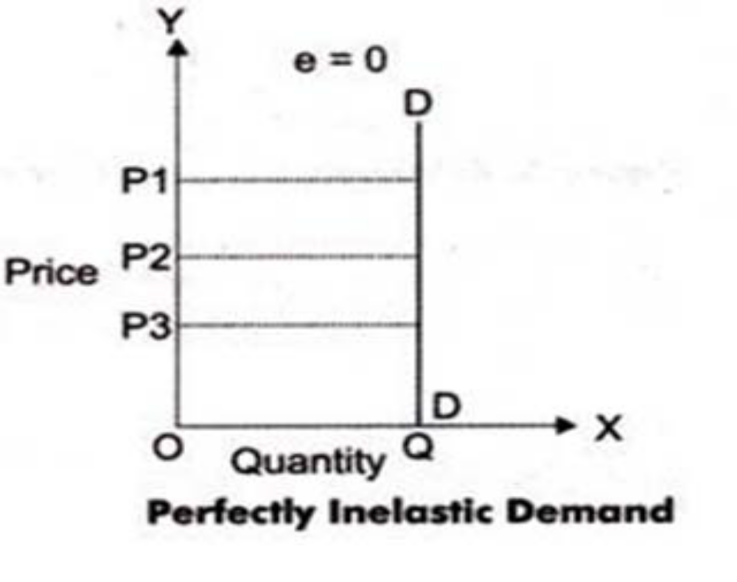
Shape of Demand curve: Vertical

Slide 27
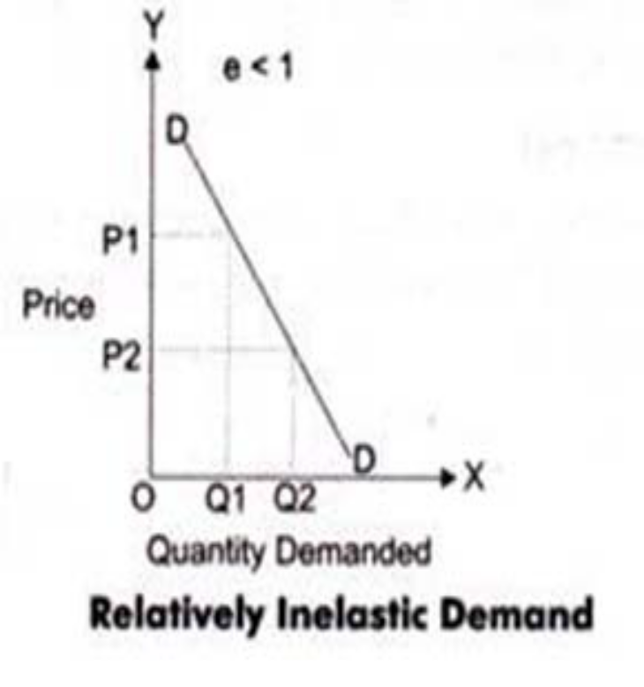
2. RELATIVELY INELASTIC DEMAND (EP< 1 )
Description: when to a percentage change in price there is less than proportionate change in quantity demanded.
Types of Goods: Necessities like food, fuel
Shape of Demand curve: Steeper
Changes in price yield an insignificant change in demand

Slide 28
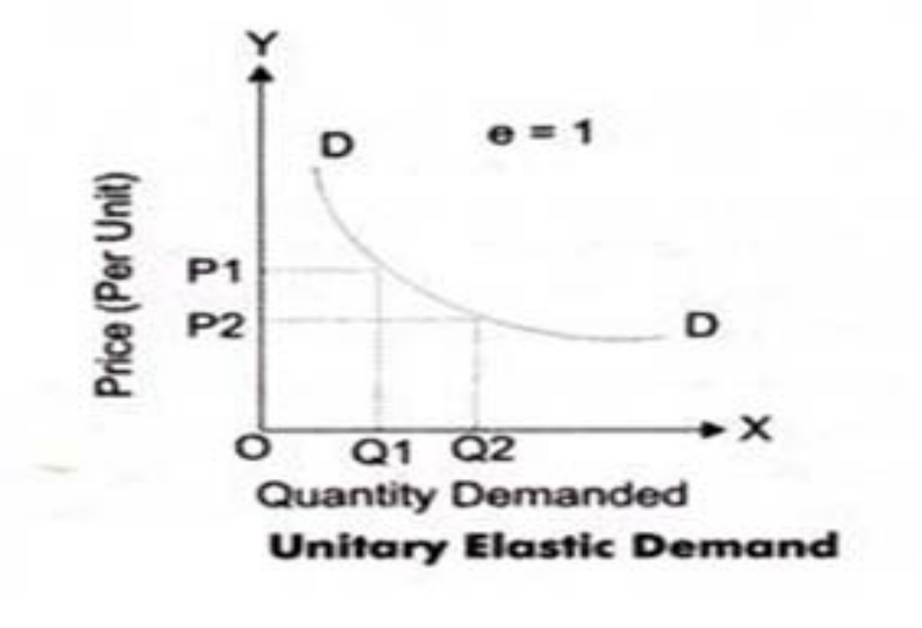
3. UNITARY ELASTIC DEMAND ( EP = 1)
Description: when to a percentage change in price there is equal change in quantity demanded.
Types of Goods: Normal goods
Shape of Demand curve: the linear demand curve forming 45o angle both the axes
Changes in price yield equivalent (%) changes in demand

Slide 29
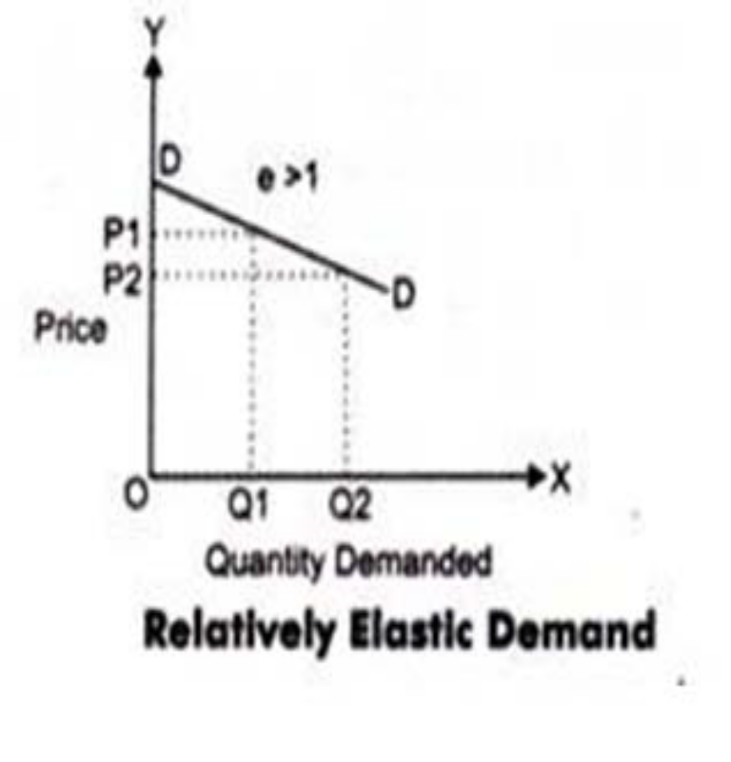
4. RELATIVELY ELASTIC DEMAND (EP> 1)
Description: when to a percentage change in price there is more than proportionate change in quantity demanded.
Types of Goods: Luxuries
Shape of Demand curve: Flatter
Changes in price yield a significant change in demand

Slide 30
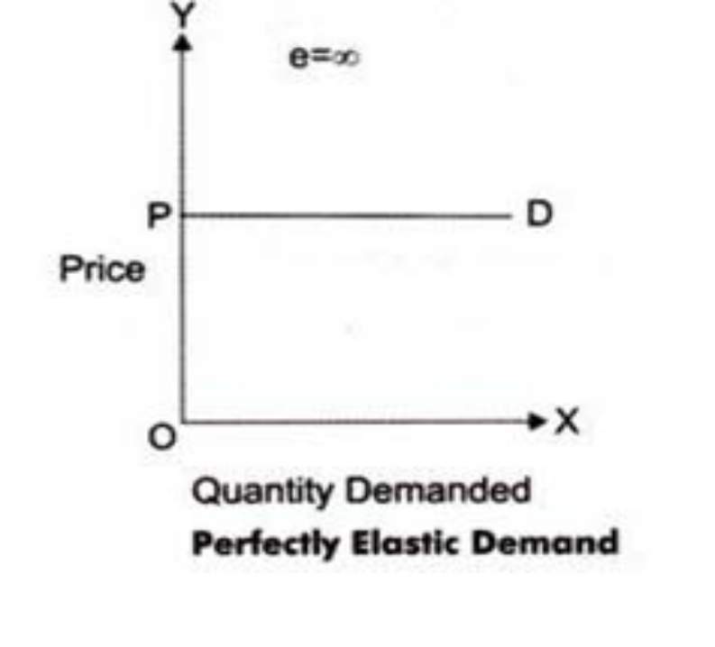
5. PERFECTLY ELASTIC DEMAND (EP = ∞)
Description: when there is infinite change in quantity situation demanded without any changes in price
Types of Goods: Imaginary
Shape of Demand curve: Horizontal
Changes in price result in demand declining to zero

Slide 31
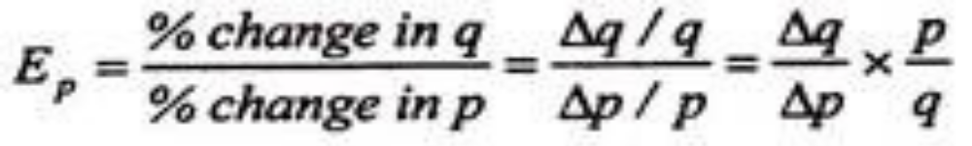
METHODS OF CALCULATING PRICE ELASTICITY OF DEMAND
1. The Percentage Method:
The price elasticity of demand is measured by its coefficient (Ep). This coefficient (Ep) measures the percentage change in the quantity of a commodity demanded resulting from a given percentage change in its price.
Where q refers to quantity demanded, p to price and Δ to change. If EP>1, demand is elastic. If EP< 1, demand is inelastic, and Ep= 1, demand is unitary elastic.

Slide 32
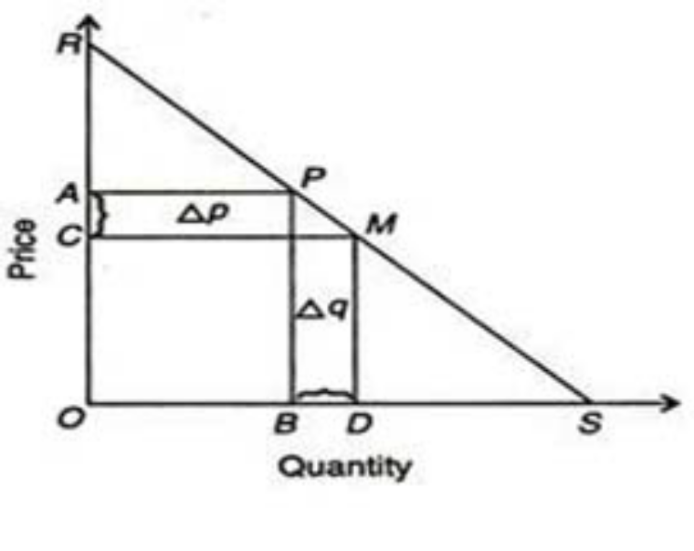
2. The Point Method or Geometrical or graphical method:
The point method of measuring elasticity of demand was developed by Alfred Marshall. Elasticity measures at a point on a demand curve is known as point elasticity of demand
Let RS be a straight line demand curve in Figure. If the price falls from PB ( = OA) to MD ( = OC), the quantity demanded increases from OB to OD.

Slide 33
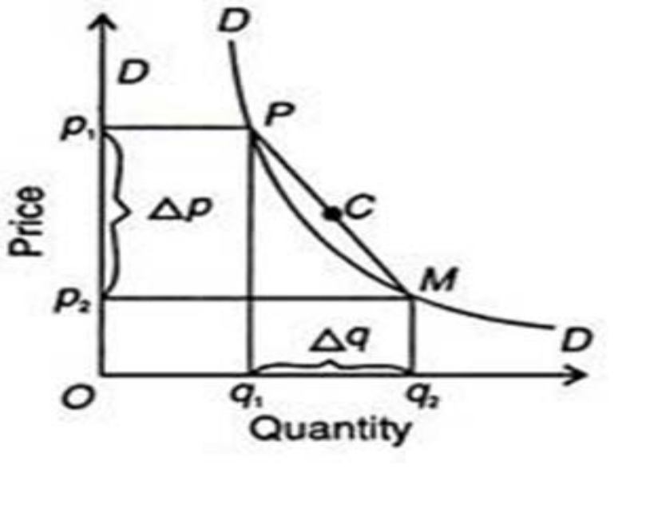
3. The Arc Method:
When elasticity of demand is measured over a finite range or ‘arc’ of a demand curve, it is called arc elasticity of demand. when elasticity is measured between two points on the same demand curve, it is known as arc elasticity.

Slide 34
CONT…
The area between P and M on the DD curve in Figure is an arc which measures elasticity over a certain range of price and quantities.
Elasticity for the arc (PM in Figure ) is calculated by taking the average of the two prices [(p1 + p2 )½] and the average of the two quantities [(q, +q2 )½].
The formula for price elasticity of demand at the mid-point (C in Figure 4) of the arc on the demand curve.

Slide 35
The Total Outlay Method:
Marshall evolved the total outlay, or total revenue or total expenditure method as a measure of elasticity. By comparing the total expenditure of a purchaser both before and after the change in price, it can be known whether his demand for a good is elastic, unity or less elastic.
Total outlay is price multiplied by the quantity of a good purchased: Total Outlay = Price x Quantity Demanded.

Slide 36
EXAMPLES
A dealer in deep freezers increased the price of his products from K450 to K500.
And his sales dropped from 800 units to 600 units,
Use the information above to answer the questions below:
A) Calculate the price elasticity of demand
B) What type of elasticity is this?
C) Was the decision to increase price Okay for the business? Why?
P1=K450, P2 = K500, Change in P, =50
Q1 = 800 units, Q2 = 600 units Change in Q = -200 units
Ep = (Change in Q)/Q x P/(Change in P) = -200/800 x 450/50 = -2.25

Slide 37
CONT…
Or % Change in Qd /% Change in P = [((600-800)/800)x100]/[((500-450)/450)x100] = 25% /11.1% = 2.25
The elasticity is Relative Elastic demand
Q2. Calculate the arc elasticity using the data below
P1 = K1000, P2 = 800 Q1 = 200 UNITS , Q2 = 300 UNITS
Pe = [(Q2 – Q1)/9(Q1+Q2)/2] / [(P2-P1)/(P1+P2)/2]
Pe = - 1.8

Slide 38
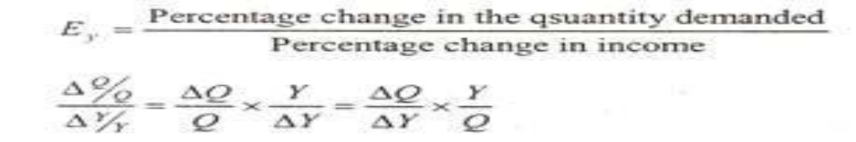
INCOME ELASTICITY OF DEMAND
Income elasticity of demand is the degree of responsiveness of demand to the change in income.
Where,
Q = Original quantity
Y = Original income
ΔQ = Changes in quantity
ΔY = Changes in income
Ey = Income elasticity of demand

Slide 39
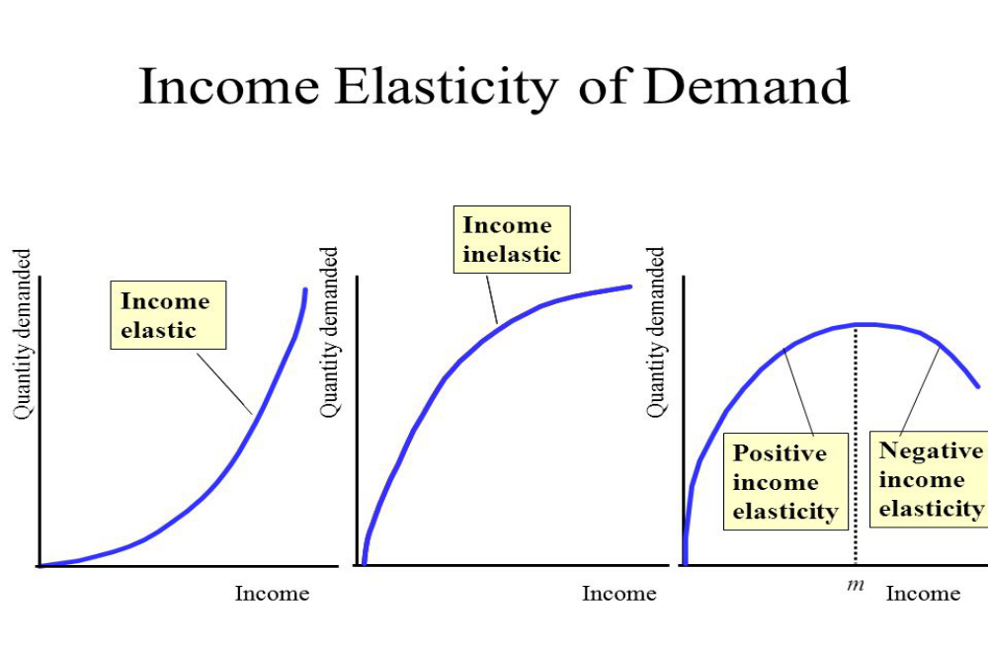
CONT…

Slide 40
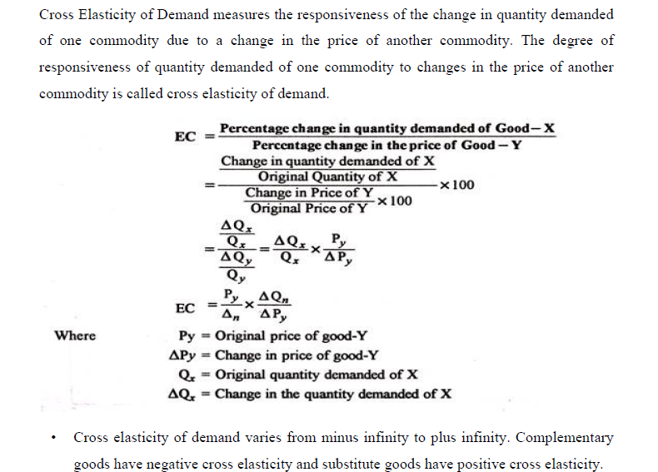
CROSS ELASTICITY OF DEMAND

Slide 41
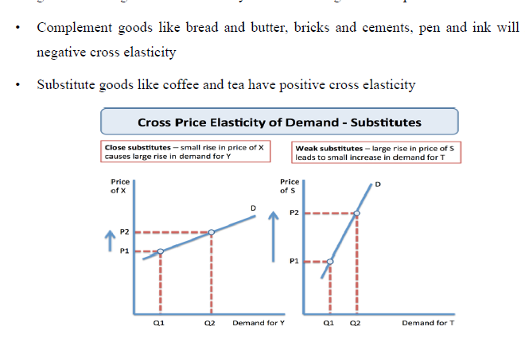
CONT…

Slide 42
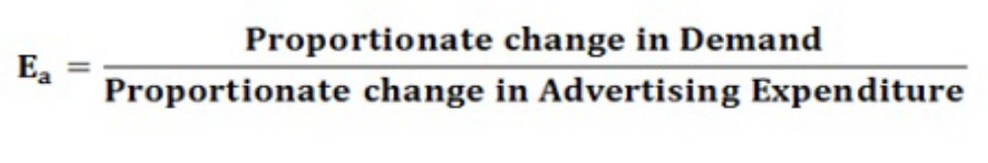
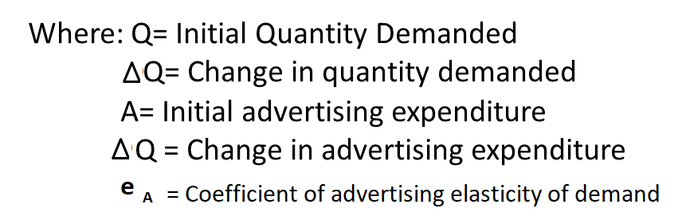
ADVERTISING ELASTICITY OF DEMAND
It measures the response of quantity demanded due to change in advertising expenditure. It is also called promotional elasticity of demand

Slide 43
DETERMINANTS OF ADVERTISING ELASTICITY OF DEMAND
The Main factors affecting advertising elasticity of demand are:
Stage of product market: Advertising elasticity is different for new products and for old products.
It is also different for products with established market and a growing market.
2. Effect of advertising by rivals: The effectiveness of advertising depends upon how the rivals react to the advertising campaign of this firm.
3. Effect of advertising in terms of time: the time lag in response to advertisement differs.
It depends upon the types of product. It takes longer in case of durable good because will buy durable goods only after the existing one has been used up.

Slide 44
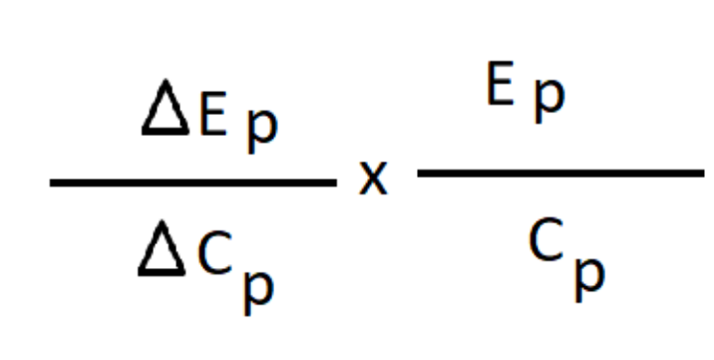
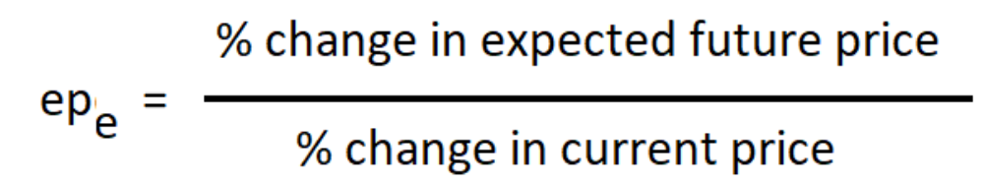
ELASTICITY OF PRICE EXPECTATIONS
The concept of elasticity of price expectations was developed by J.R.Hicks.
Elasticity of price expectations is defined as the ratio of the relative change in expected future prices to the relative change in current price.
It is symbolically
=

Slide 45
LAW OF SUPPLY
The relationship between price and quantity supplied is usually a positive relationship. A rise in price is associated with a rise in quantity supplied.
Definitions
Dooley says "The law of supply states that other things being equal the higher the price, the greater the quantity supplied or the lower the price, the smaller the quantity supplied.“
Lipsey, defines it as "The law of supply states that other things being equal, the quantity of any commodity that firms will produce and offer for sale is positively related to the commodity's own price, rising when price rises and falling when price falls.“
As the price of good increases, suppliers will attempt to maximize profits by increasing the quantity of the product sold.

Slide 46
SUPPLY SCHEDULE
PRICE OF APPLES | QUANTITY OF APPLES SUPPLIED
10 | 100
11 | 150
12 | 200
13 | 250

Slide 47
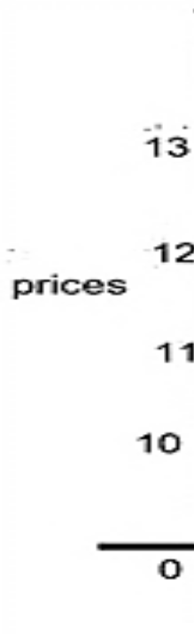
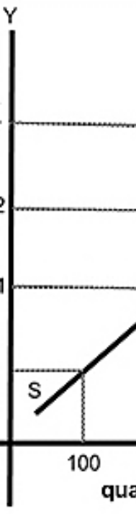
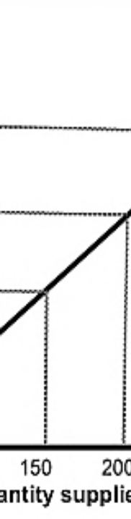
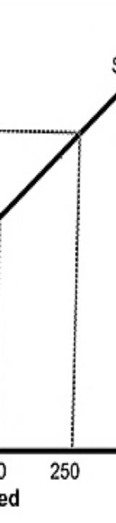
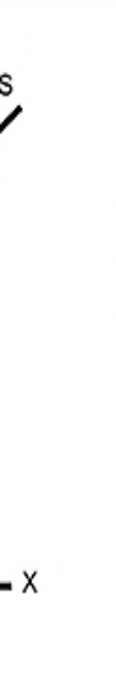
SUPPLY CURVE

Slide 48
DETERMINANTTS OF SUPPLY
1. Cost of factors of production
Price of raw materials
Rent and interest on Machinery
Cost of Machinery
Payments on Human Resources (wages & Salaries)
Payments on Transport
If Production is high Supply will be low

Slide 49
2. State of technology
Use of technology reduces cost of production
Increases production capacity
Which increases supply
3. Factors outside the Economic Sphere.
The factors below should not rise, if they rise they affect supply directly or indirectly.
Weather conditions,
Wars
Unexpected situations like epidemics (COVID-19)
Floods

Slide 50
5. TAX AND SUBSIDY
If Tax subsidy (Charge less tax) is given by the government
Cost of production is low but if not
The cost of production rises
Leading to low production which will effect decrease in supply.
6. Goal of business firm
7. Price of related goods
8 Change in number of companies in the industry

Slide 51
Movement along the Supply Curve
A change in price causes a movement along the supply curve; such a movement is called a change in quantity supplied.
As is the case with a change in quantity demanded, a change in quantity supplied does not shift the supply curve. By definition, it is a movement along the supply curve.
For example, if the price rises from P1 to P3, the quantity supplied rises from Q1 to Q3 and that is an expansion in supply.
When the price drops from P1 to P2, the quantity supplied drops from Q1 to Q2 and that is a contraction in supply.

Slide 52
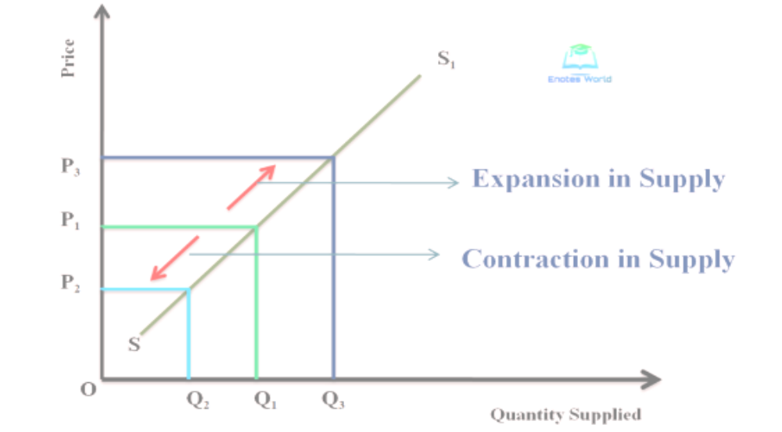
SUPPLY CURVE

Slide 53
Shifts in the Supply Curve
Shifts in supply curve arise from changes in the following
The cost of production for the firms:
For example, autoworkers in Zambia represented by a union might negotiate a new labour contract for higher wages.
This represents a cost increase on the part of firms and will result in a leftward shift of the supply curve.
Technology that affects the production function:
For example, a new robotic technology that aids in the assembly of automobiles in the factory could improve the efficiency of the plant, resulting in a rightward shift of the supply curve.

Slide 54
SHIFTS IN SUPPLY CURVE
The number of sellers in the market:
For example, perhaps a new company, like Toyota decides to begin to manufacture cars in Zambia, the number of sellers has increased, and the number of cars for sale is likely to increase as well, leading to a rightward shift in the supply curve.
• The presence of alternative markets for sellers:
For example, an economic boom in Zambia might cause South African manufacturers to send more of the cars they produce to Zambia instead of selling them in South African, leading to a lower supply of cars in the South African market represented by a leftward shift in the supply curve.

Slide 55
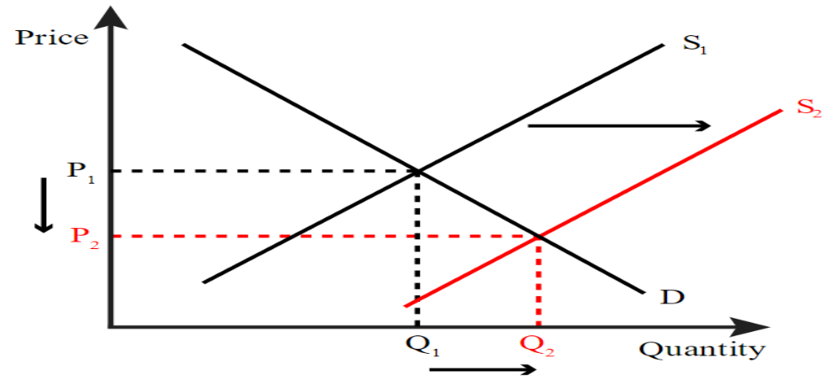
Increase in Supply

Slide 56
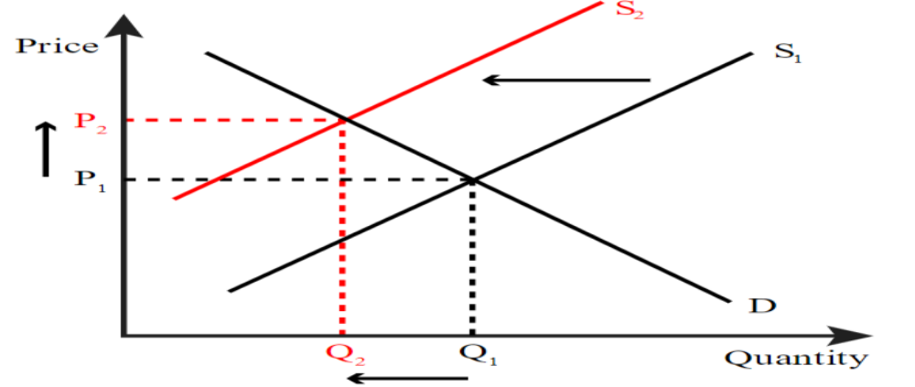
Decrease in Supply

Slide 57
Equilibrium Demand and Supply, Consumer Surplus and Producer surplus
Market equilibrium is the quantity-price point where supply and demand balance out in such a way that quantity demanded equals quantity supplied.
The market stabilizes at the price that corresponds to this quantity. When visualized on a graph, the economic equilibrium is the point of intersection between the demand and supply curves.
This point of intersection reflects the compromising quantity that both consumers are willing to seek out and producers are willing to supply at a certain price.

Slide 58
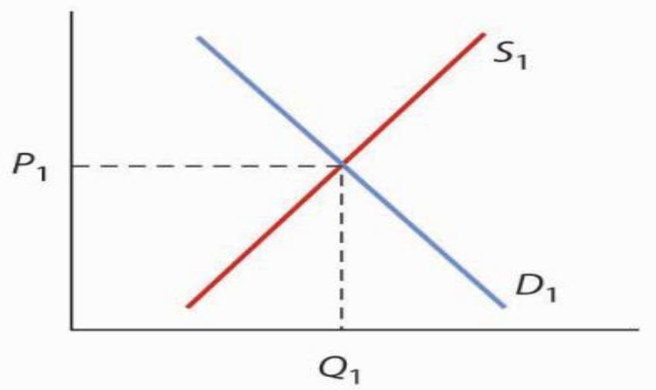
EQUILIBRIUM CURVE

Slide 59
Market Supply Schedule:
It is a summation of the individual supply schedules and depicts the supply of different customers for a commodity in relation to its price. Let us understand it with the help of an example.
Price per unit of Banana Qty supplied by firm A (QA) Qty supplied by firm B (QB) Market Supply QA + QB
100 40 50 40 + 50 =90
200 60 70 60 + 70 = 130
300 65 80 65 + 80 = 145
400 80 100 80 + 100 = 180

Slide 60
Consumer surplus & Producer surplus
Consumer surplus is the difference that the consumer has to pay for a good or service and the price they would be willing to pay rather than forego that good or service.
Producer surplus is the difference between how much a supplier would be willing to receive for a given quantity of good or service and how much they can actually receive for that quantity based on the market price.

Slide 61
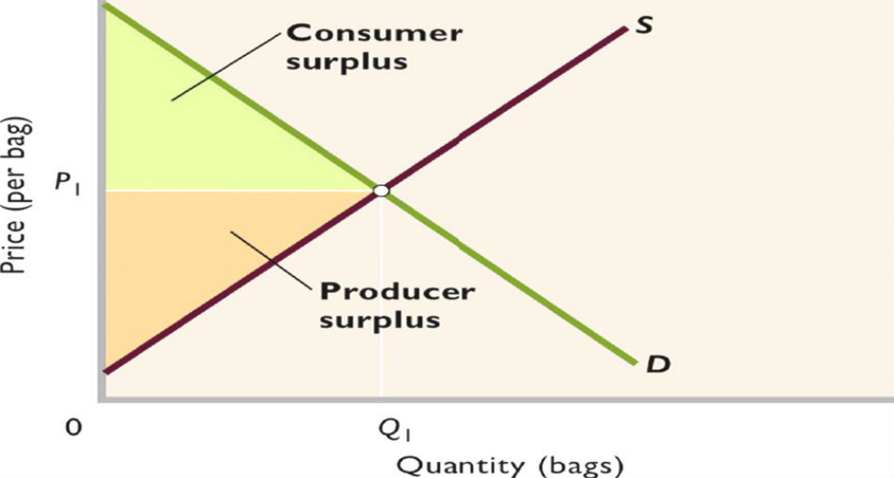
Consumer surplus & Producer surplus

Slide 62
Price Floor and Ceiling
Laws that government enacts to regulate prices are called Price controls. Price controls come in two flavors. A price ceiling keeps a price from rising above a certain level (the “ceiling”), while a price floor keeps a price from falling below a certain level (the “floor”).
Price ceiling: is a maximum price that can be charged for a product or service. A price ceiling is non-binding when it doesn't have an effect on the market price. A non-binding price ceiling occurs when the price level is greater than or equal to the market equilibrium price. For example, rent control and gasoline.
Price floor: is a minimum price at which a product or service is permitted to sell. A price floor is non-binding when it doesn't have an effect on the market price. A non-binding price floor occurs when the price level is less than or equal to the market equilibrium price. For example, agricultural products and minimum wage

Slide 63
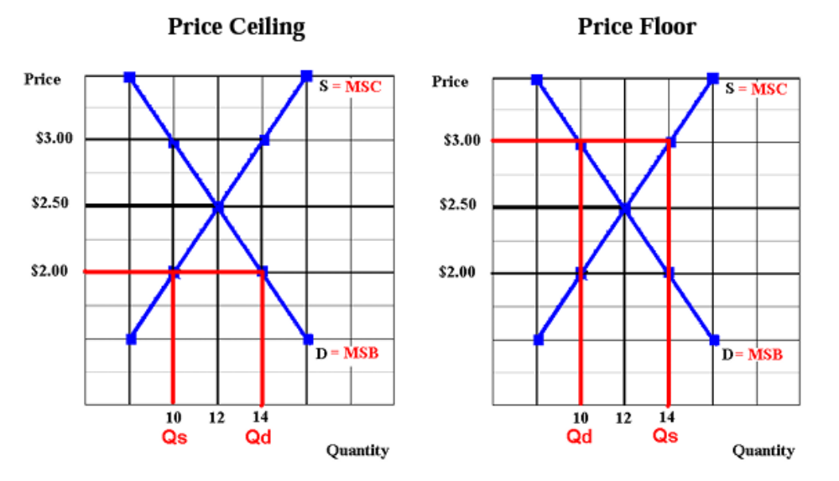
Price Ceiling & Price Floor

Slide 64
At Market Equilibrium
Price = $2.50 and Quantity = 12
The point is also the allocative efficient quantity because at Quantity = 12, Marginal Social Benefit = Marginal Social Cost
Price Ceiling
Ceiling Price = $ 2.00 Quantity Demand = 14 while Quantity Supply 10
Therefore, the shortage is equal to 4 and this shows that, there is an allocative inefficiency: at the quantity of 10, Marginal Social Benefit > Marginal Social Cost, so there is an under allocation of resources.

Slide 65
Price Floor
Floor Price = $ 3.00 Quantity Demand = 10 while Quantity Supply 14
Therefore, the surplus is equal to 4 and this shows that, there is an more efficiency: at the quantity of 14,
Marginal Social Benefit < Marginal Social Cost,
so there is an over allocation of resources.

